Slide 1
Characterizing Physical Properties of Hierarchical Structure in Star-Forming Regions
James Lilly
Advisor: Dr. Yancy Shirley, University of Arizona
2020 Arizona Space Grant Symposium

Slide 2
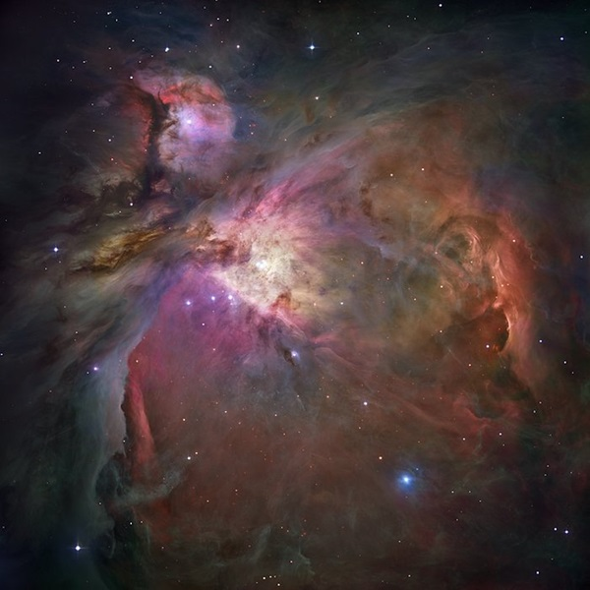
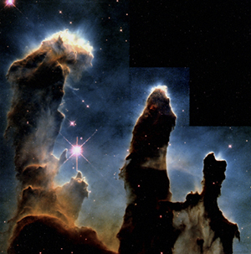
Questions
How can we accurately identify dense pre-stellar cores within molecular clouds?
How can we accurately measure their physical properties (e.g. size, mass, gravitational boundness)?
NASA, ESA, M. Robberto (Space Telescope Science Institute/ESA) and the Hubble Space Telescope Orion Treasury Project Team
NASA, Hester and Scowen

Slide 3
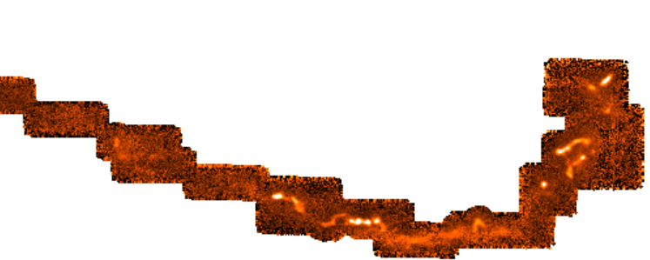
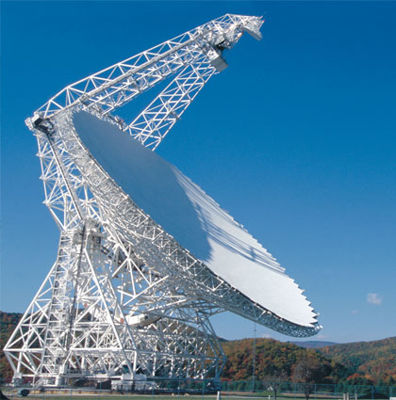
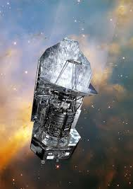
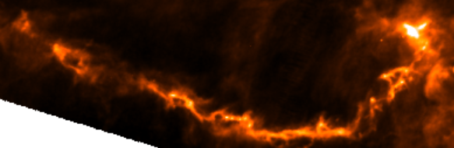
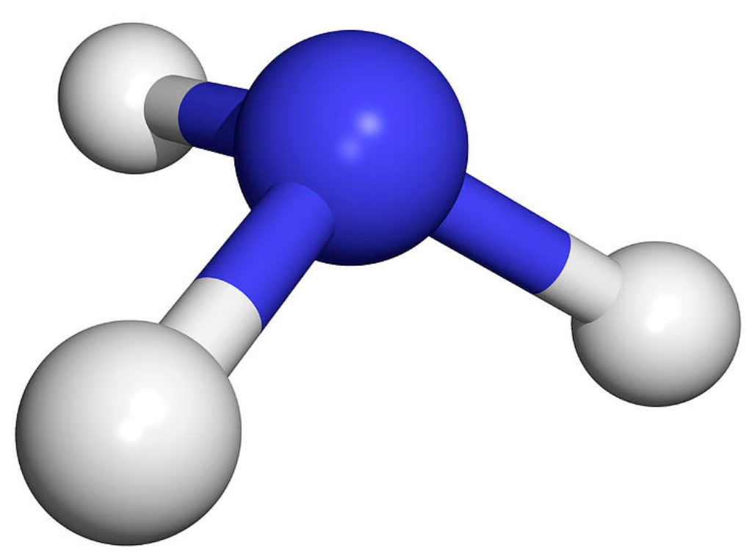
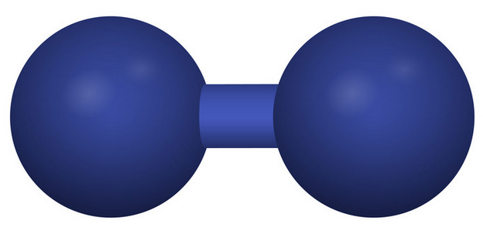




Background
Radio/Far-Infrared Observations
Look Inside the Clouds
$$I(NH_{3})$$
Herschel Gould Belt Survey; Ayushi Singh (UToronto)
NRAO
ESA AOES Medialab; background: HST, NASA/ ESA/ STScI
$$N(H_{2})$$
$$NH_{3}$$
$$H_{2}$$
VectorStock - Meggi
Dr. Tim Evans
Green Bank Telescope, Youngmin Seo (JPL)

Slide 4
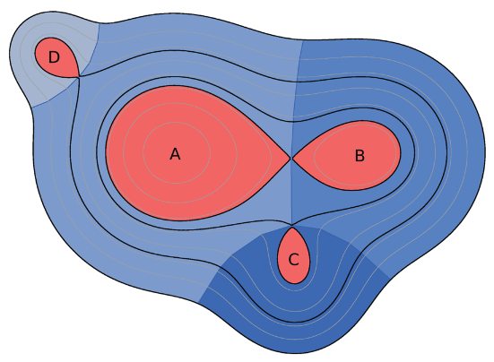
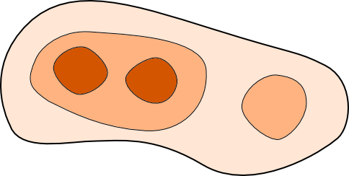
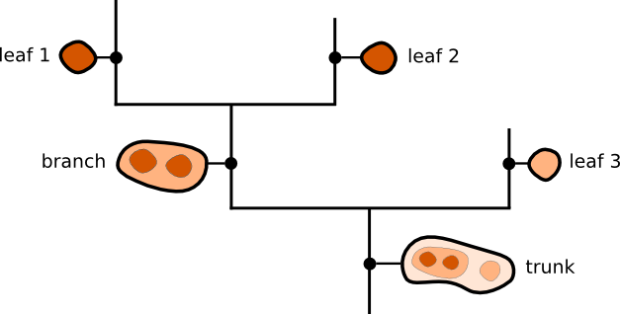
Methods
Hierarchical Structure Algorithms (Dendrograms)
CSAR: Uses pixel stream
Astrodendro: Pixel-by-pixel
André et al. 2013
www.dendrograms.org

Slide 5
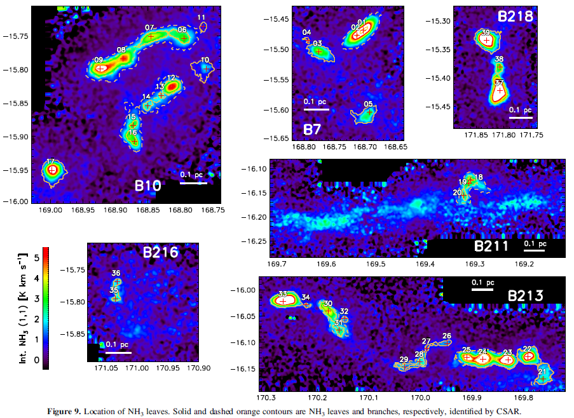
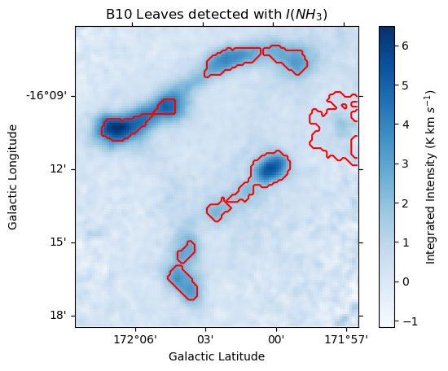
Results
Very similar structures from different algorithms
CSAR Cores
Astrodendro Cores
7
6
8
10
9
12/13
14
15
16
Seo et al. 2015

Slide 6
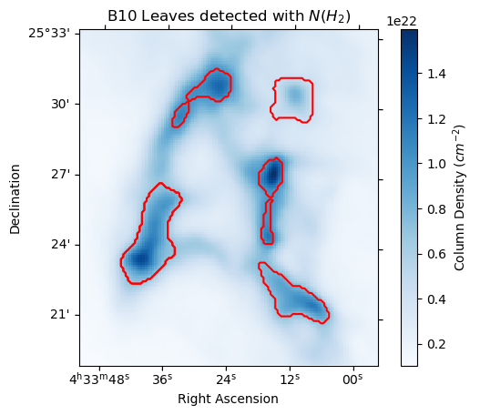
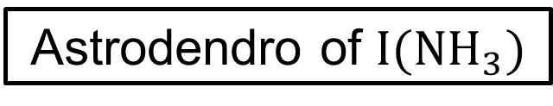
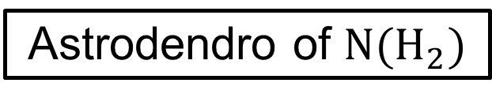
Results
      Different structures identified for different datasets
Astrodendro of $I({NH}_{3})$
Astrodendro of $N(H_{2})$
7
6
8
10
9
12/13
14
15
16
From left to right. A) Leaves identified in B10 at 5σ level for $I\left(NH_{3}\right)$ map. B) Leaves identified in B10 at 5σ level for $N\left(H_{2}\right)$ map

Slide 7
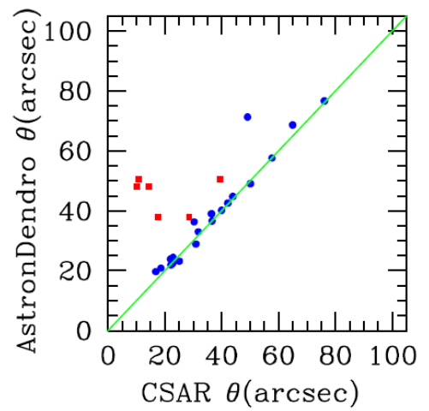
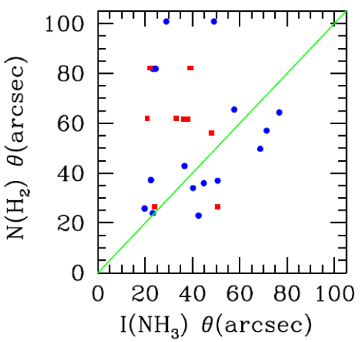
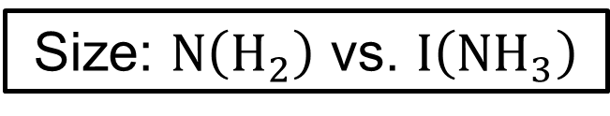
Results
      Physical property variations are minimal for different algorithms, but substantial for different datasets
Size: Astrodendro vs. CSAR
Size: $N\left(H_{2}\right)$ vs. $I\left({NH}_{3}\right)$
Dr. Yancy Shirley
Dr. Yancy Shirley

Slide 8
Acknowledgments
Thanks to my advisor, Dr. Yancy Shirley, for all his support
Thanks to Michelle Coe for orchestrating this internship and symposium
The material contained in this document is based upon work supported by a National Aeronautics and Space Administration (NASA) grant or cooperative agreement. Any opinions, findings, conclusions or recommendations expressed in this material are those of the author and do not necessarily reflect the views of NASA. This work was supported through a NASA grant awarded to the Arizona/NASA Space Grant Consortium.
This research made use of astrodendro, a Python package to compute dendrograms of Astronomical data (http://www.dendrograms.org/)

